Slide 1
Final Presentation
Team Indigo 20200854 황찬기 / 20210210 이다민 / 20220019 안재영

Slide 2
Overall progress
Week | Progress
Week 1 | Created Project Repository / Fixed Meeting Plan & Tools to Use
Week 2 | Decided Git Convention / Researched Basic Concepts of Project
Week 3 | Researched about Each Steps for Implementing / Basic Structure Design
Week 4 | Detailed Structure Design
Week 5 | Set gRPC & Basic Scala Project Files on Git
Week 6 | Intermediate Presentation / Reset Project Structure Design
Week 7 | Implemented gRPC / Sampling & Partitioning / Shuffling & Merging Each
Week 8 | Tried to Merge All Implemented Features

Slide 3
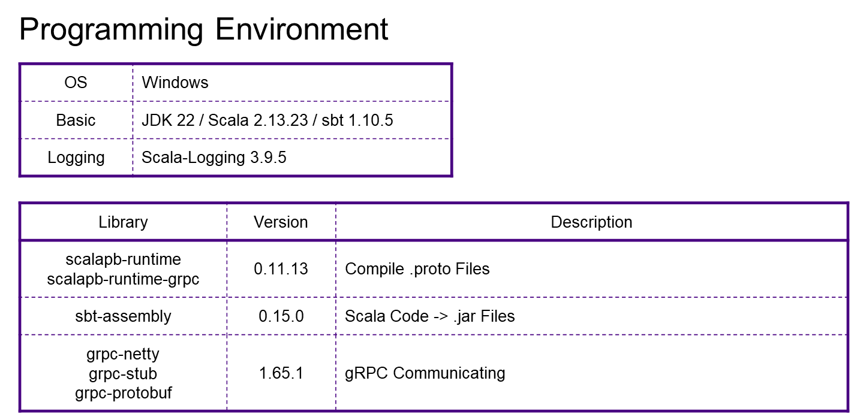
Member | Role
황찬기 | Initial setting & gRPC Connection
이다민 | Shuffling & Merging
안재영 | Samping & Partitioning

Slide 4
Overall progress
Before Progress Presentation
initial setting → sorting → sampling → partitioning → shuffling → merging
After
initial setting → sampling → partitioning → sorting → shuffling → merging
We changed our roles, according to each phases
took lots of time by connecting members’ phases

Slide 5
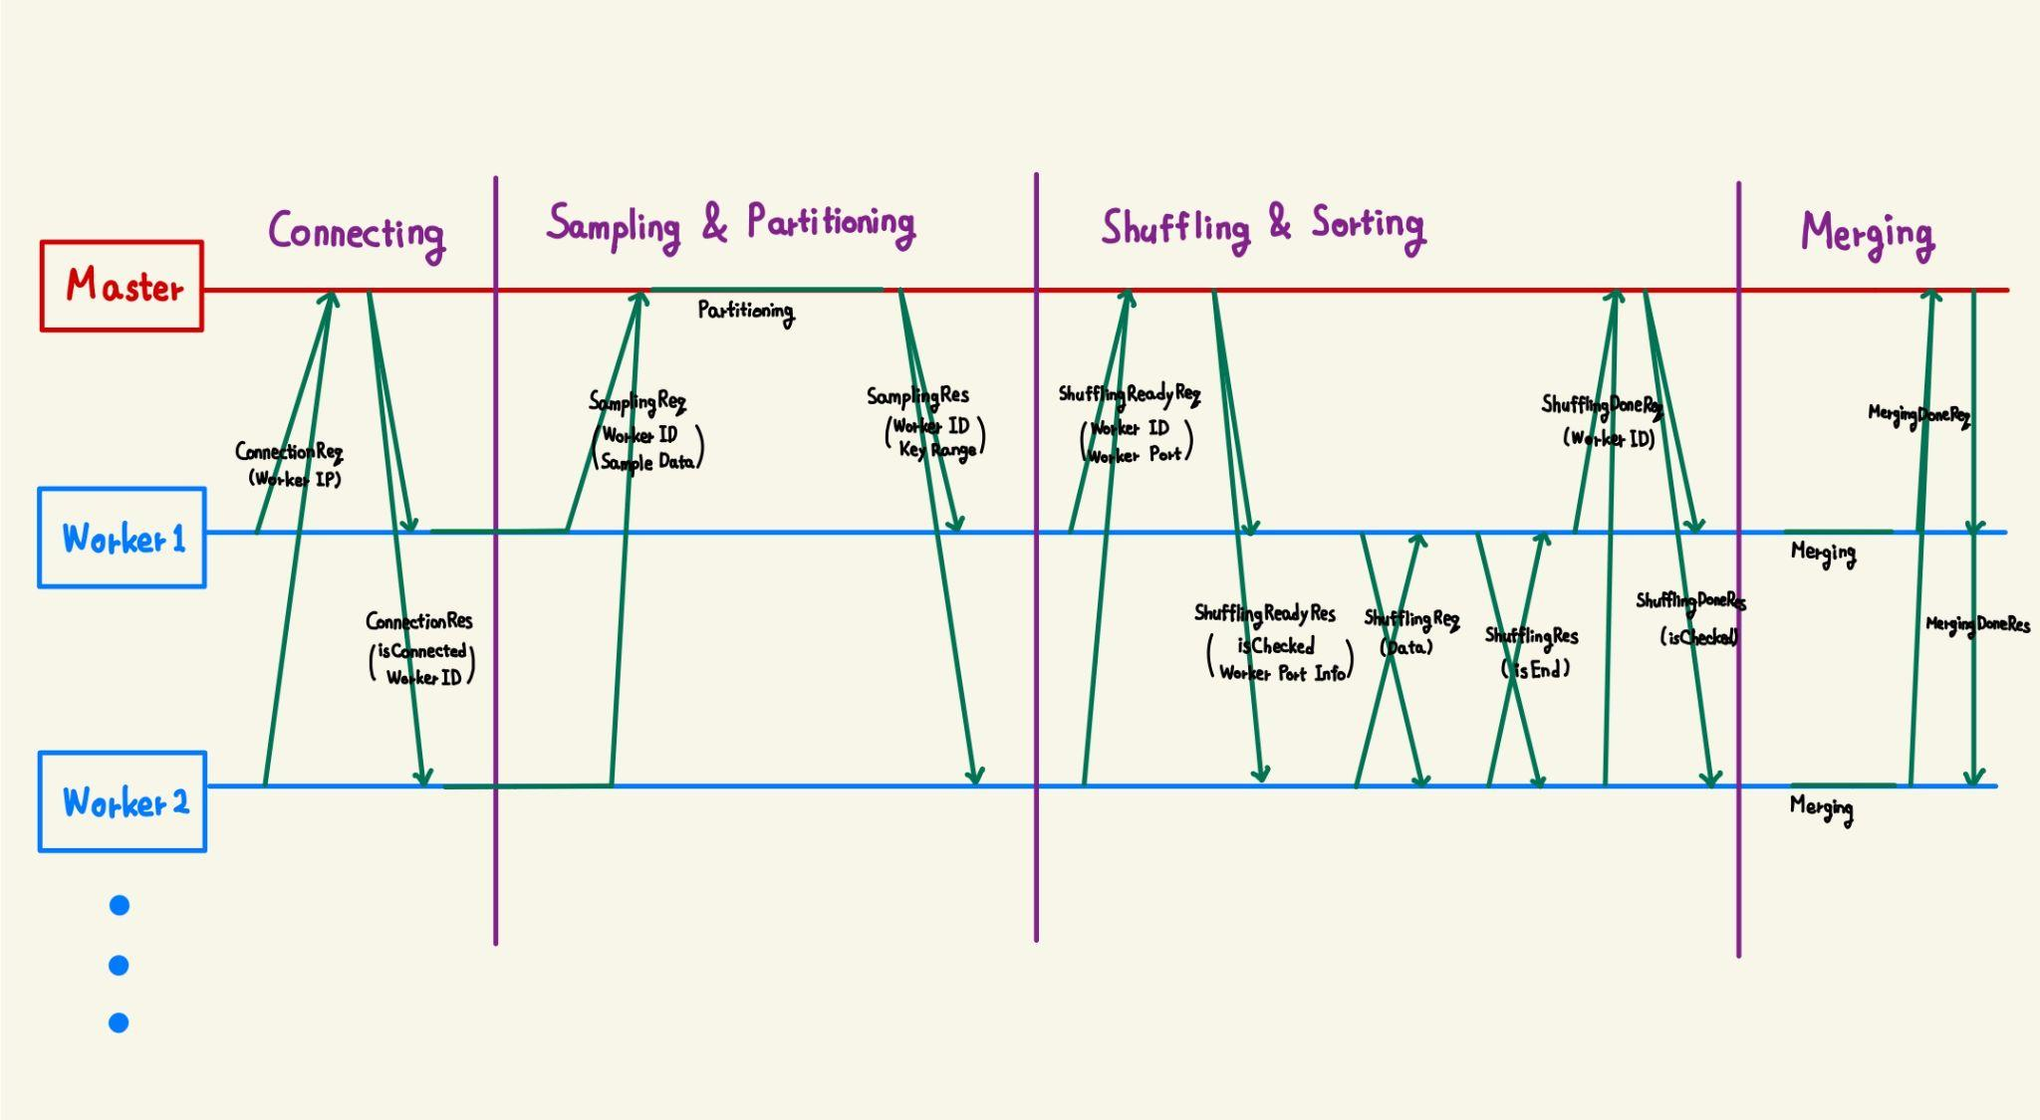
Final architecture (master & worker)

Slide 6
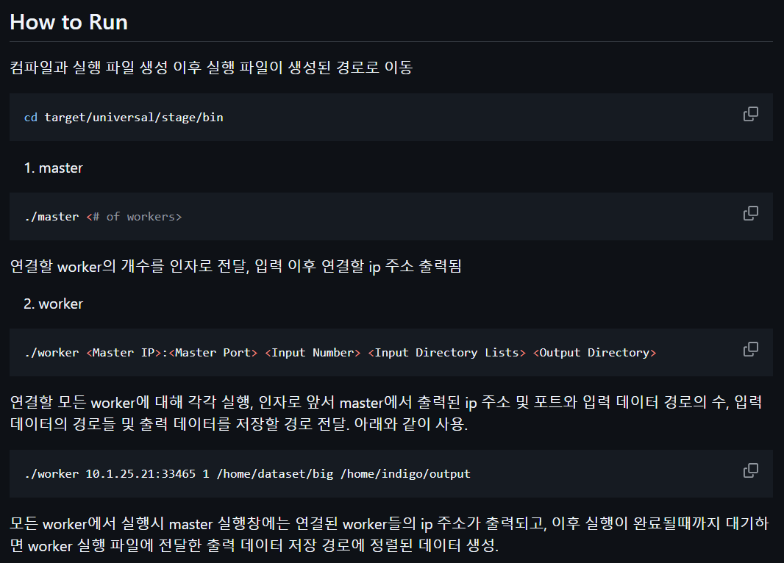
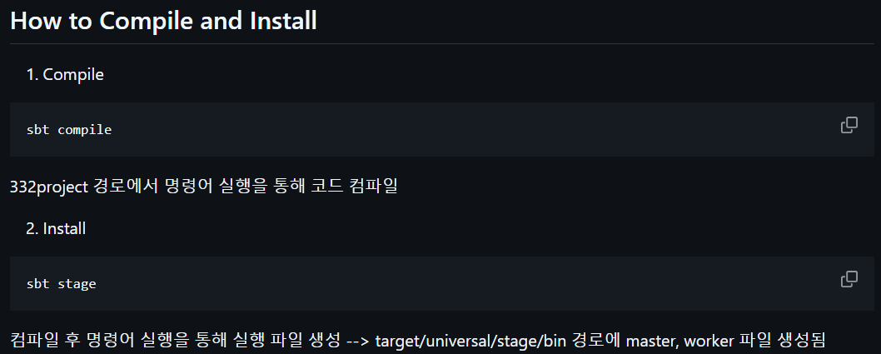
How to Run

Slide 7
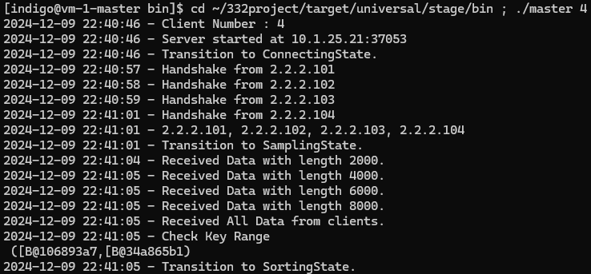
Final execution
Successfully Connected Master - Workers
Workers create sample and successfully send it to master
Master calculates key range and successfully send it to worker
We could get some sorted files during the sorting state of worker
Master successfully prints changes of these sorting phases
But after the sorting state is not completed

Slide 8
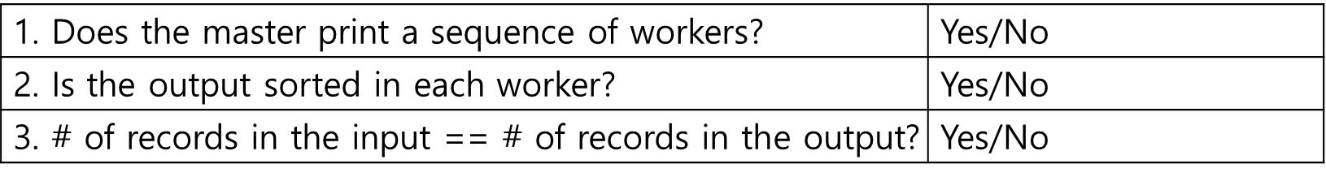
Experiment
We failed to implement complete sorting
each member tried to implement each part of sorting, but failed to merge & fix bugs
we ended up at sorting phase (initial setting → sampling → partitioning → sorting → shuffling → merging ( → finish))

Slide 9
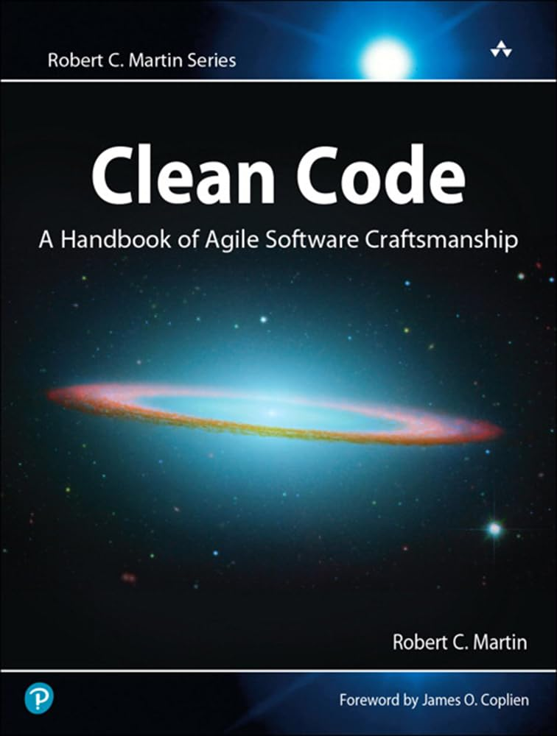

Analysis of Failures
Less Error Checking Code & Test Code
From Clean Code Ch.7
Less Error Checking Code -> LOG LOG LOG LOG LOG
More Online / Less Offline
We tried to meet offline once a week, but it was too less.
Wasted too much time on trivial things
After progress presentation, we had to make code but …
Optimism
From Mythical Man-Month Ch.2
We did not consider communication overhead enough
Merging each part of members was hard

Slide 10
Analysis of Failures
Less Error Checking Code & Test Code
From Clean Code Ch.7
Less Error Checking Code -> LOG LOG LOG LOG LOG
Wasted too much time on trivial things
After progress presentation, we had to make code but …
Optimism
From Mythical Man-Month Ch.2
We did not consider communication overhead enough
Merging each part of members was hard

Slide 11
Lessons learned from the project
Use time more efficiently & Use more time
Run toy code first, then try to get more deeper

